Slide 1
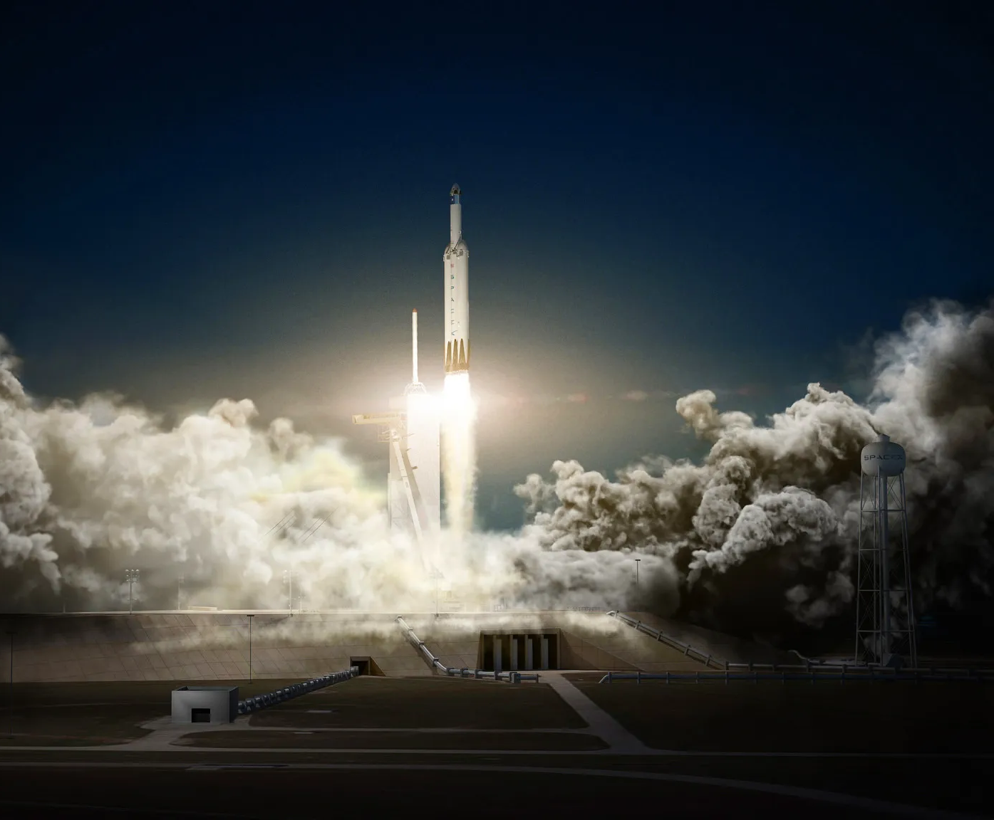

APPLIED DATA SCIENCE CAPSTONE PROJECT
SpaceX Falcon 9 Landing Analysis
- MD Humayun Kabir

Slide 2

OUTLINE
Executive Summary
Introduction
Methodology
Results
Discussion
Conclusion

Slide 3
EXECUTIVE SUMMARY
This project analyzes SpaceX launch data to predict whether the Falcon 9 first stage will land successfully. Key steps include:
1. Data Preparation – Cleaning and formatting launch records.
2. Exploratory Analysis – Identifying trends and influential factors.
3. Interactive Visualizations – Exploring correlations with success rates.
4. Machine Learning – Training models, with Decision Trees performing best.
The results help understand which launch conditions lead to successful landings, demonstrating the value of ML in aerospace.

Slide 4
INTRODUCTION
SpaceX's Falcon 9 offers cost-effective launches at 62 million —much cheaper than competitors 165 million — thanks to reusable first stages. By predicting whether the first stage will land successfully, we can estimate launch costs, providing valuable insights for competitive bidding.
While some ocean landings are intentional, our goal is to determine landing success based on key factors like payload mass, orbit type, and launch site. Using machine learning, we'll analyze these features to answer: Will the Falcon 9's first stage land successfully?
This project will help assess SpaceX's cost advantage and support strategic decision-making in the space launch industry.

Slide 5
METHODOLOGY
The overall methodology includes:
Data collection, wrangling, and formatting, using:
SpaceX API
Web scraping
Exploratory data analysis (EDA), using:
Pandas and NumPy
SQL
Data visualization, using:
Matplotlib and Seaborn
Folium
Dash
Machine learning prediction, using
Logistic regression
Support vector machine (SVM)
Decision tree
K-nearest neighbors (KNN)

Slide 6
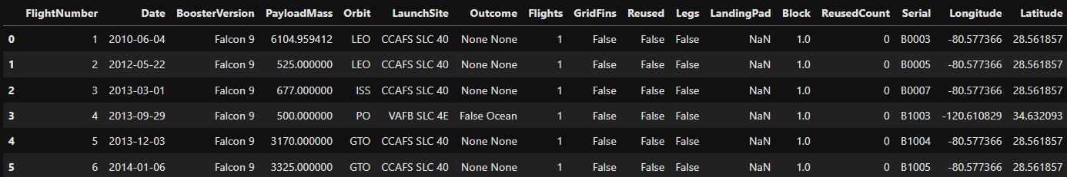
METHODOLOGY :
Data collection, wrangling, and formatting
SpaceX API: We obtained launch data from SpaceX's official API (https://api.spacexdata.com/v4/rockets/), focusing exclusively on Falcon 9 missions.
Data Cleaning Process:
Filtered to include only Falcon 9 launches
Handled missing values by imputing column means
Final dataset contains 90 launches with 17 key features
The processed dataset captures critical launch parameters needed for our landing success prediction analysis. Below is a preview of the structured data:

Slide 7
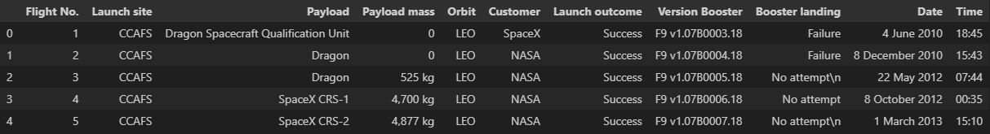
METHODOLOGY :
Data collection, wrangling, and formatting
Web Scrapping:
The data is scraped from https://en.wikipedia.org/w/index.php?title=List_of_Falcon_9_and_Falcon_Heavy_launches&oldid=1027686922
The website contains only the data about Falcon 9 launches.
We end up with 121 rows or instances and 11 columns or features. The picture below shows the first few rows of the data:

Slide 8
METHODOLOGY :
Exploratory Data Analysis (EDA)
Pandas and NumPy
Functions from the Pandas and NumPy libraries are used to derive basic information about the data collected, which includes:
The number of launches on each launch site
The number of occurrence of each orbit
The number and occurrence of each mission outcome
SQL
The data is queried using SQL to answer several questions about the data such as:
The names of the unique launch sites in the space mission
The total payload mass carried by boosters launched by NASA (CRS)
The average payload mass carried by booster version F9 v1.1

Slide 9
METHODOLOGY :
Data Visualization
Matplotlib and Seaborn
Functions from the Matplotlib and Seaborn libraries are used to visualize the data through scatterplots, bar charts, and line charts.
The plots and charts are used to understand more about the relationships between several features, such as:
The relationship between flight number and launch site
The relationship between payload mass and launch site
The relationship between success rate and orbit type
Folium
Functions from the Folium libraries are used to visualize the data through interactive maps.
The Folium library is used to:
Mark all launch sites on a map
Mark the succeeded launches and failed launches for each site on the map
Mark the distances between a launch site to its proximities such as the nearest city, railway, or highway

Slide 10
METHODOLOGY :
Data Visualization
Dash
Functions from Dash are used to generate an interactive site where we can toggle the input using a dropdown menu and a range slider.
Using a pie chart and a scatterplot, the interactive site shows:
The total success launches from each launch site
The correlation between payload mass and mission outcome (success or failure) for each launch site

Slide 11
METHODOLOGY :
Machine Learning Prediction
Functions from the Scikit-learn library are used to create our machine learning models.
The machine learning prediction phase include the following steps:
Standardizing the data
Splitting the data into training and test data
Creating machine learning models, which include:
Logistic regression
Support vector machine (SVM)
Decision tree
K nearest neighbors (KNN)
Fit the models on the training set
Find the best combination of hyperparameters for each model
Evaluate the models based on their accuracy scores and confusion matrix

Slide 12
RESULTS
The results are split into 5 sections:
SQL (EDA with SQL)
Matplotlib and Seaborn (EDA with Visualization)
Folium
Dash
Predictive Analysis
In all of the graphs that follow, class 0 represents a failed launch outcome while class 1 represents a successful launch outcome.

Slide 13
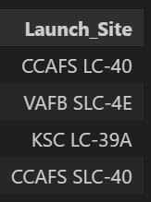
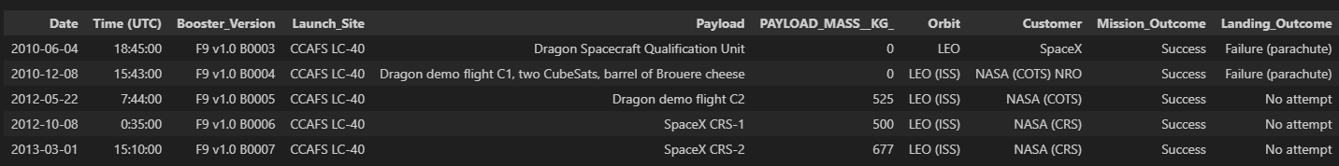
The names of the unique launch sites in the space mission
5 records where launch sites begin with ‘CCA’
RESULTS :
SQL – EDA with SQL

Slide 14
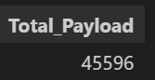
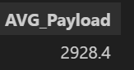

RESULTS :
SQL – EDA with SQL
The total payload mass carried by boosters launched by NASA (CRS)
The average payload mass carried by booster version F9 v1.1
The date when the first successful landing outcome in ground pad was achieved

Slide 15
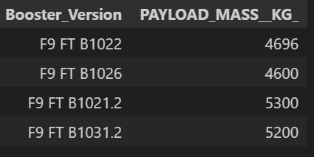
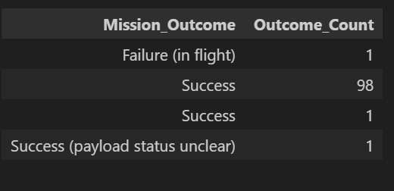
RESULTS :
SQL – EDA with SQL
The names of the boosters which have success in drone ship and have payload mass greater than 4000 but less than 6000
The total number of successful and failure mission outcomes

Slide 16
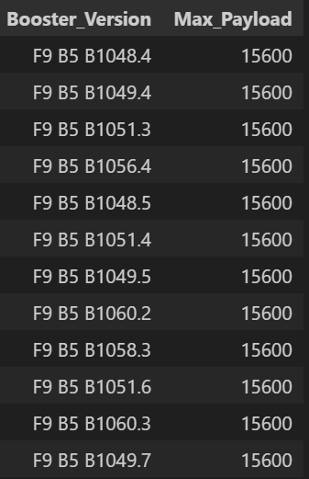
RESULTS :
SQL – EDA with SQL
The names of the booster versions which have carried the maximum payload mass

Slide 17
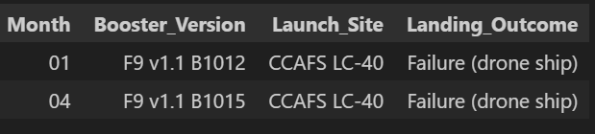
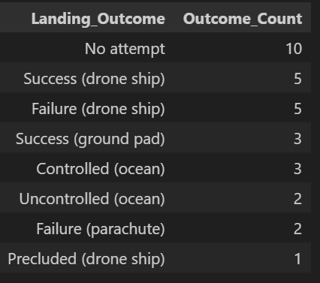
RESULTS :
SQL – EDA with SQL
The failed landing outcomes in drone ship, their booster versions, and launch site names for in year 2015
The count of landing outcomes between the date 2010-06-04 and 2017-03-20, in descending order

Slide 18
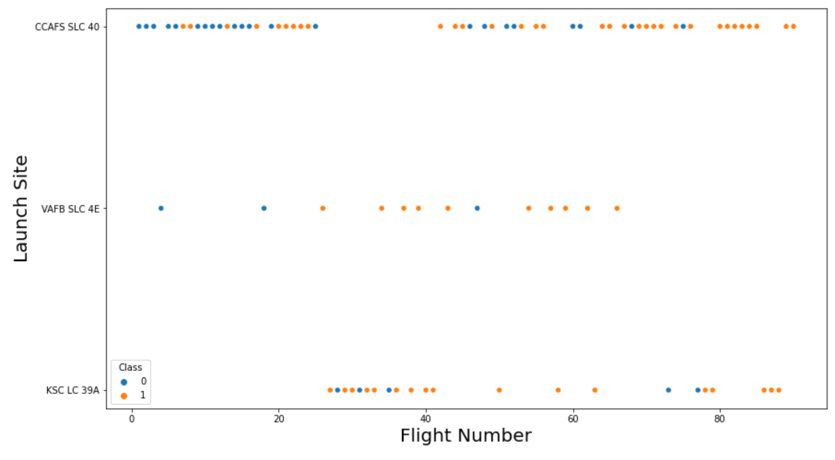
RESULTS :
Matplotlib and Seaborn (EDA with Visualization)
The relationship between flight number and launch site

Slide 19
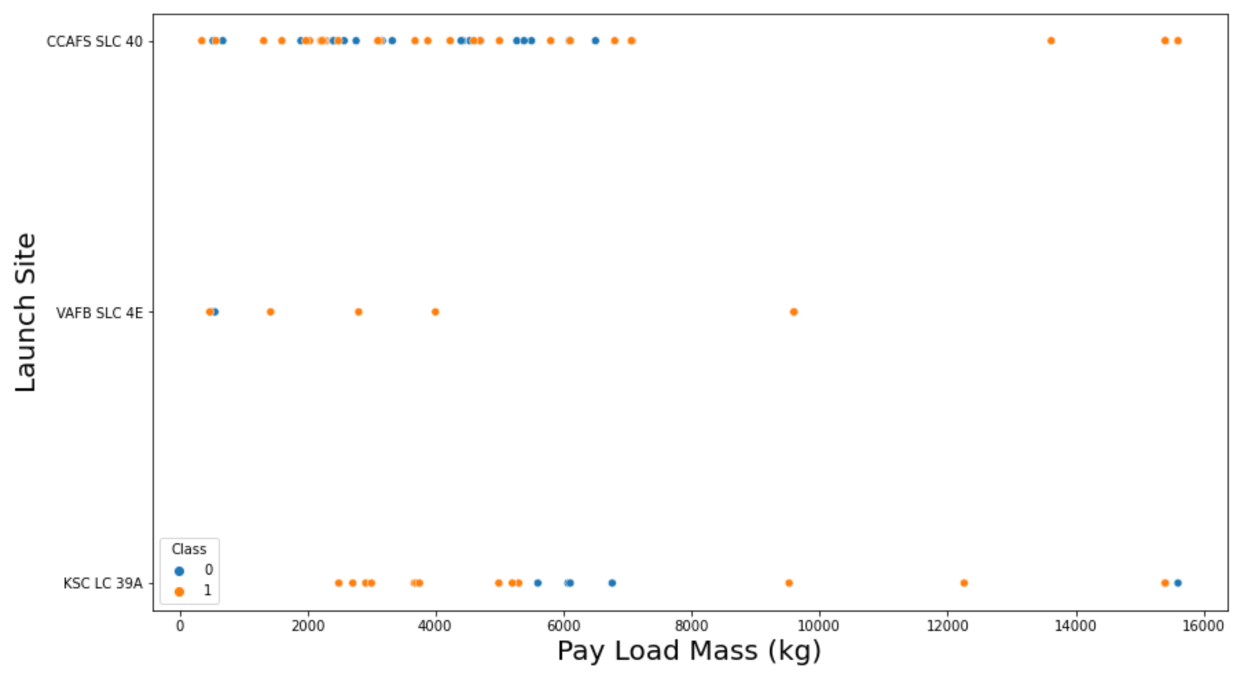
RESULTS :
Matplotlib and Seaborn (EDA with Visualization)
The relationship between payload mass and launch site

Slide 20
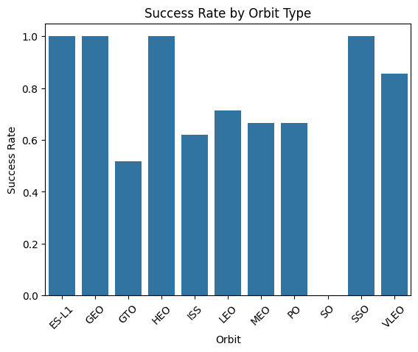
RESULTS :
Matplotlib and Seaborn (EDA with Visualization)
The relationship between success rate and orbit type

Slide 21
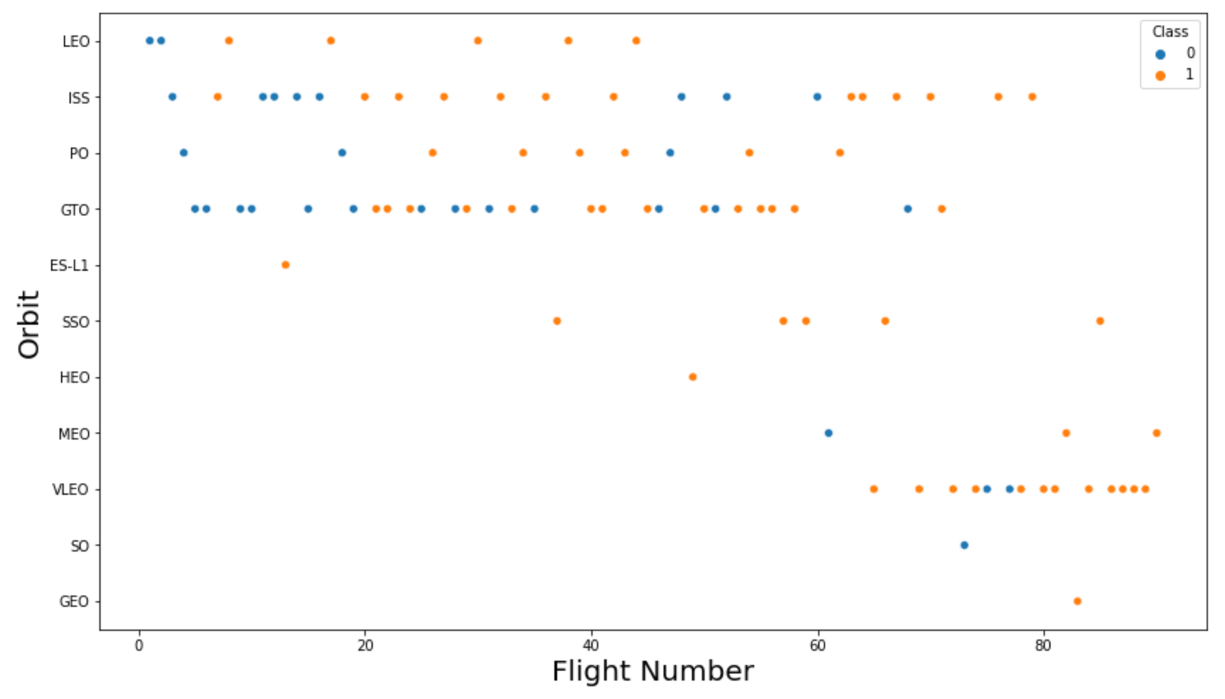
RESULTS :
Matplotlib and Seaborn (EDA with Visualization)
The relationship between flight number and orbit type

Slide 22
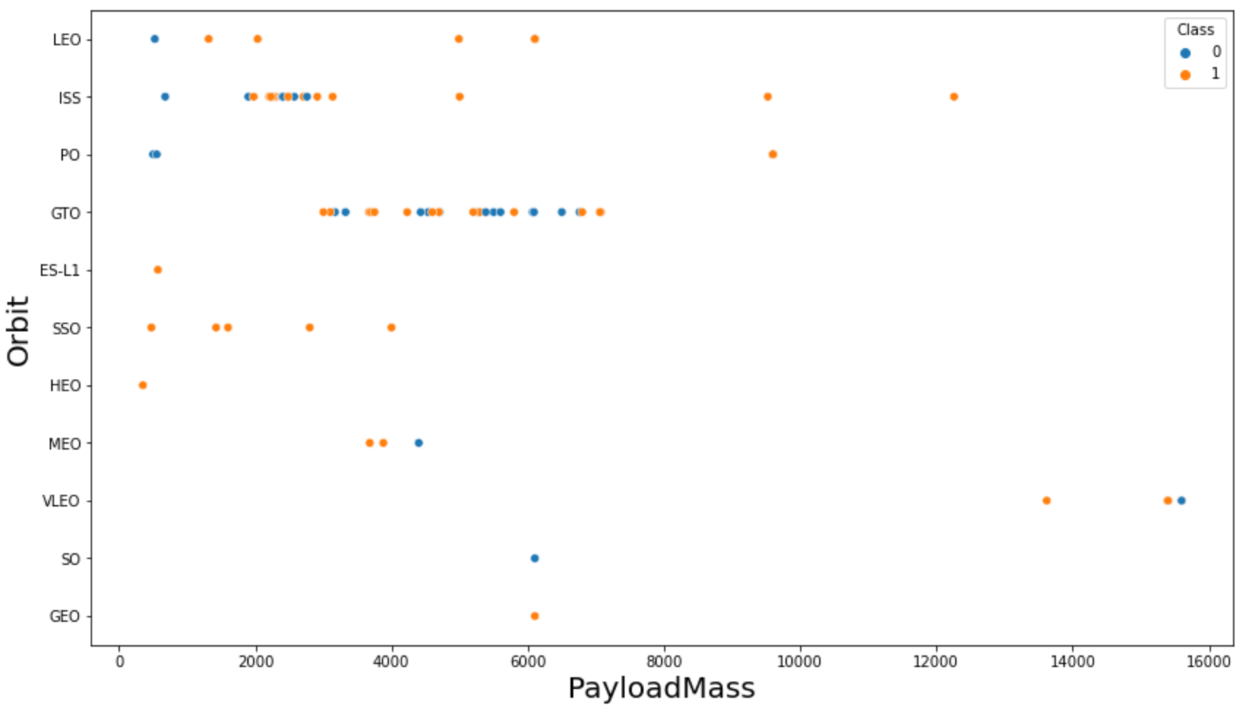
RESULTS :
Matplotlib and Seaborn (EDA with Visualization)
The relationship between payload mass and orbit type

Slide 23
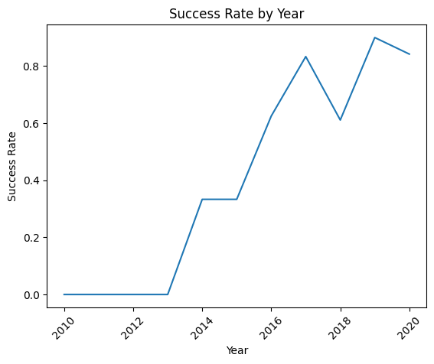
RESULTS :
Matplotlib and Seaborn (EDA with Visualization)
The launch success yearly trend

Slide 24

RESULTS :
Folium
All launch sites on map

Slide 25
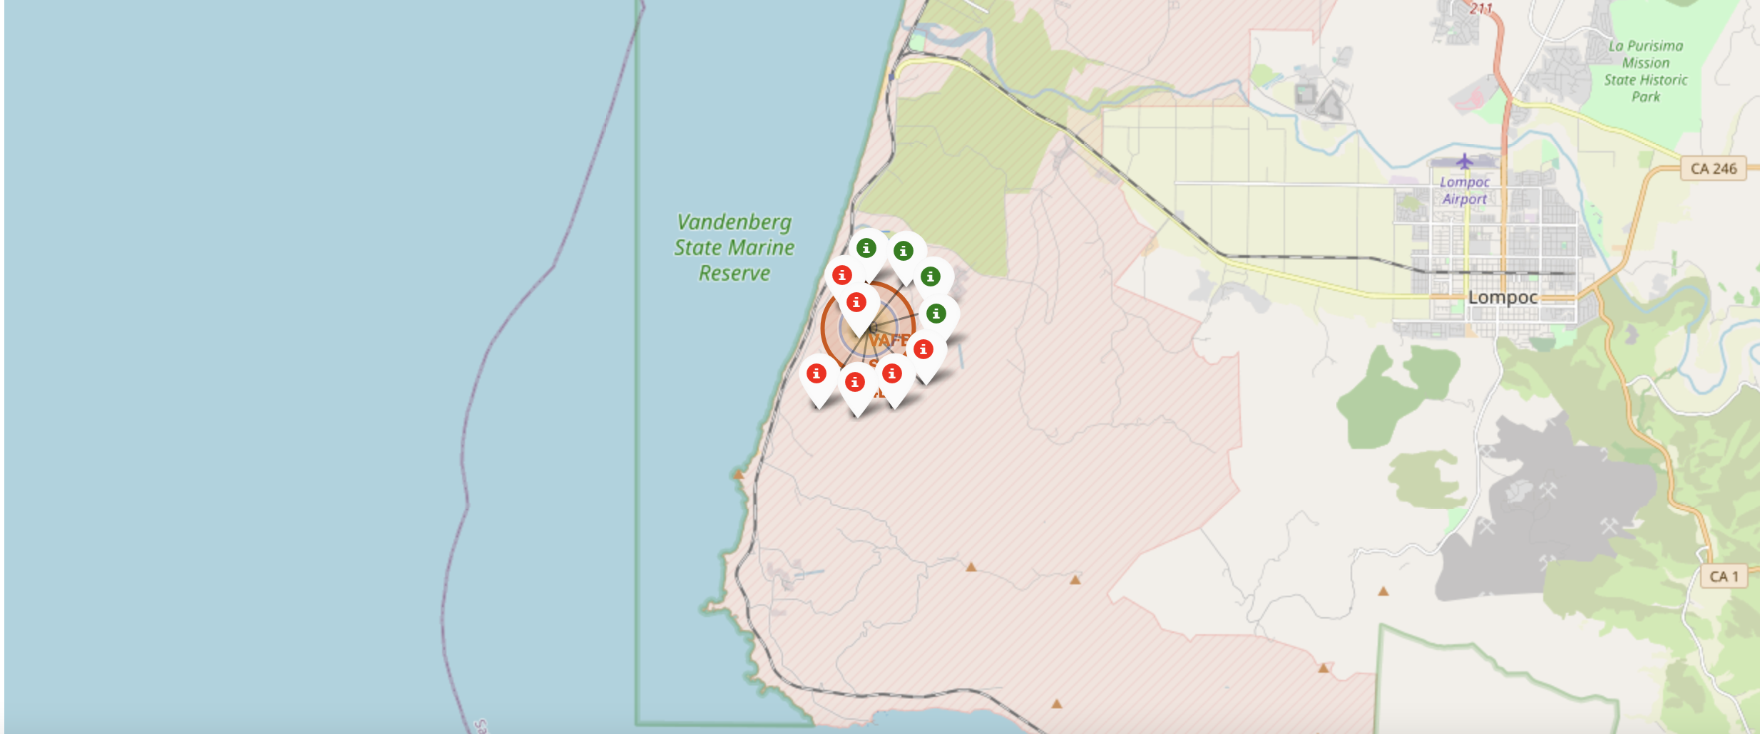
RESULTS :
Folium
The succeeded launches and failed launches for each site on map
If we zoom in on one of the launch site, we can see green and red tags. Each green tag represents a successful launch while each red tag represents a failed launch

Slide 26
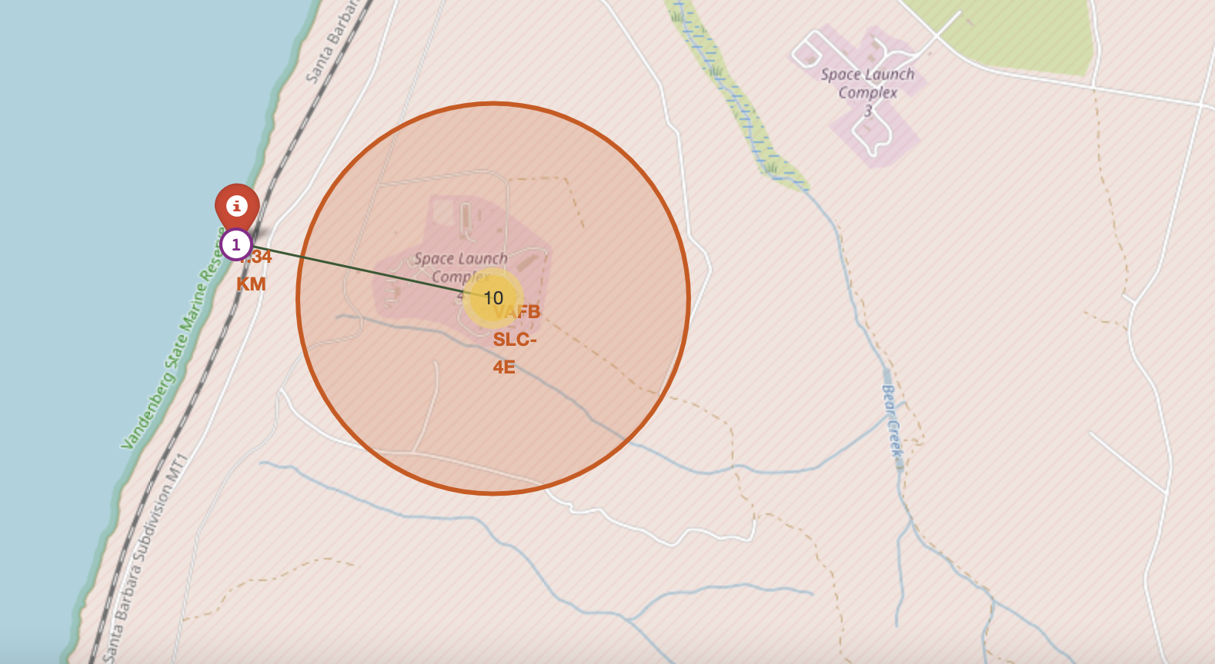
RESULTS :
Folium
The distances between a launch site to its proximities such as the nearest city, railway, or highway
The picture below shows the distance between the VAFB SLC-4E launch site and the nearest coastline

Slide 27

RESULTS :
Dash
The picture below shows a pie chart when launch site CCAFS LC-40 is chosen.
0 represents failed launches while 1 represents successful launches. We can see that 73.1% of launches done at CCAFS LC-40 are failed launches.

Slide 28
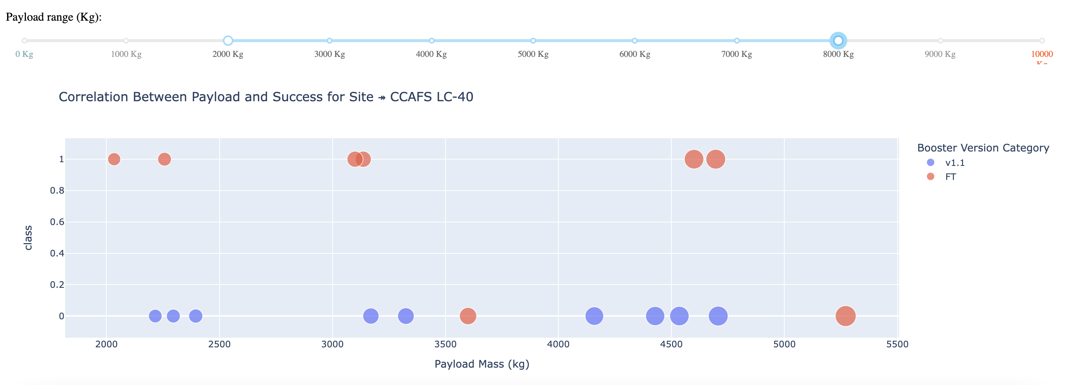
RESULTS :
Dash
The picture below shows a scatterplot when the payload mass range is set to be from 2000kg to 8000kg.
Class 0 represents failed launches while class 1 represents successful launches.

Slide 29

RESULTS :
Predictive Analysis
Logistic regression
GridSearchCV best score: 0.8464285714285713
Accuracy score on test set: 0.8333333333333334
Confusion matrix:

Slide 30
RESULTS :
Predictive Analysis
Support vector machine (SVM)
GridSearchCV best score: 0.8482142857142856
Accuracy score on test set: 0.8333333333333334
Confusion matrix:

Slide 31
RESULTS :
Predictive Analysis
Decision tree
GridSearchCV best score: 0.8892857142857142
Accuracy score on test set: 0.8333333333333334
Confusion matrix:

Slide 32
RESULTS :
Predictive Analysis
K nearest neighbors (KNN)
GridSearchCV best score: 0.8482142857142858
Accuracy score on test set: 0.8333333333333334
Confusion matrix:

Slide 33
RESULTS :
Predictive Analysis
Putting the results of all 4 models side by side, we can see that they all share the same accuracy score and confusion matrix when tested on the test set.
Therefore, their GridSearchCV best scores are used to rank them instead. Based on the GridSearchCV best scores, the models are ranked in the following order with the first being the best and the last one being the worst:
Decision tree (GridSearchCV best score: 0.8892857142857142)
K nearest neighbors, KNN (GridSearchCV best score: 0.8482142857142858)
Support vector machine, SVM (GridSearchCV best score: 0.8482142857142856)
Logistic regression (GridSearchCV best score: 0.8464285714285713)

Slide 34
DISCUSSION
Our visual analysis reveals distinct patterns in landing success rates:
Payload-Orbit Relationships:
Higher success rates observed for Polar, LEO, and ISS orbits with heavy payloads
GTO orbits show mixed outcomes regardless of payload mass
Feature Influence:
Multiple parameters appear correlated with mission success
Complex interactions make manual pattern recognition challenging
Machine Learning Approach: To effectively model these relationships, we'll employ classification algorithms to:
Learn historical success patterns
Predict outcomes based on feature combinations
Quantify each parameter's predictive importance
This data-driven approach will provide more reliable predictions than visual analysis alone.

Slide 35
CONCLUSION
This project develops a machine learning solution to predict whether SpaceX's Falcon 9 first stage will land successfully - a critical factor in determining launch costs. By analyzing various launch parameters (including payload mass and orbit type), we identify patterns that influence mission outcomes.
Our comparative analysis of multiple machine learning algorithms revealed that the Decision Tree model achieved superior performance in predicting landing success. This predictive capability enables more accurate cost estimation for Falcon 9 launches, providing valuable insights for the competitive space launch market.
The solution demonstrates how data science can extract meaningful business intelligence from complex aerospace operations.

